Slide 1

Clustering with Spotify Data
Jackson Reydel and Chidera Ugbonta

Slide 2
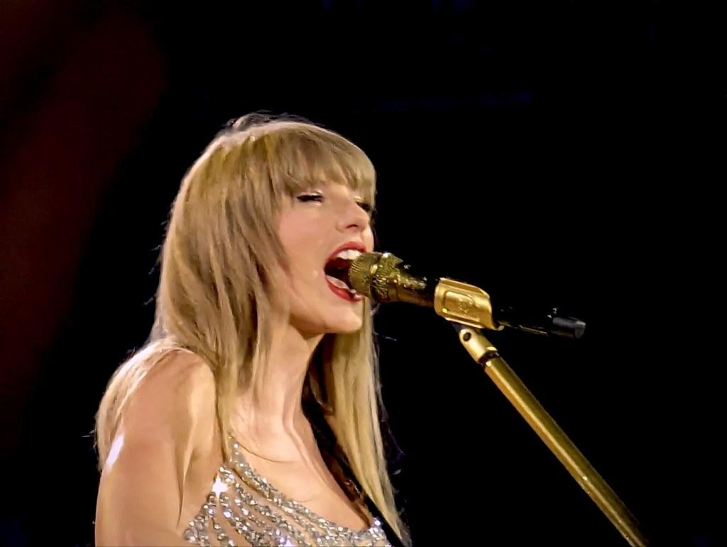

Motivation
If you love a certain artist or band, how do we suggest new artists for you to listen to?
For example, if you love Taylor Swift, you might already listen to Katy Perry and Lady Gaga. Still, if you want a new similar artist, Sabrina Carpenter might be the right choice because she shares similar song metadata

Slide 3
Dataset: Spotify Artist Metadata
Spotify uses data to give ratings on a scale for the musical makeup of each artist
Acousticness, Danceability, Energy, Instrumentalness, Liveness, Speechiness, and Valence are all graded from 0 to 1 with higher values indicating they are more acoustic, danceable, etc.
Loudness is measured in Decibels
Song Duration is measured in milliseconds
Tempo is measured in beats per minute
Popularity is measured in how many likes and plays the artist receives

Slide 4
Clustering to Create Recommendations
With tens of thousands of artists on Spotify, we want to create artist clusters that can make recommendations
Clustering can be done with just two columns of the dataset up to eleven different columns
Sklearn Machine Learning Algorithms
K-Means Clustering
Places a circle or hyper-sphere at the center of a cluster, the radius length is the distance to the farthest point of the cluster
Great for very large and evenly distributed data
Hard Classification
Each point belongs to one cluster and one cluster only
Gaussian Mixture Model Clustering
Places ellipses and other oblong objects at the center of the cluster
Great for smaller and oddly dispersed data
Soft Classification
Mixed Membership of Clusters
Determine Probabilities that each data point is in a cluster

Slide 5
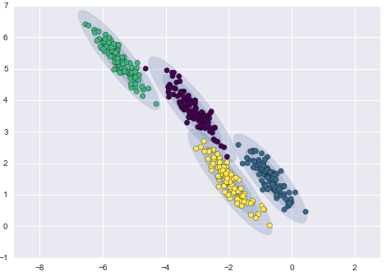
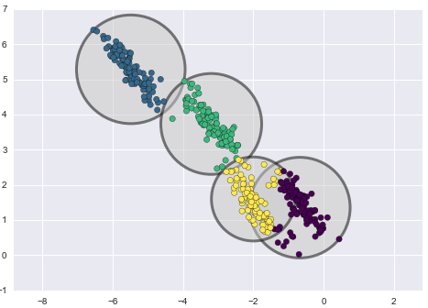
Gaussian Mixture Models Vs. K-Mean Example

Slide 6
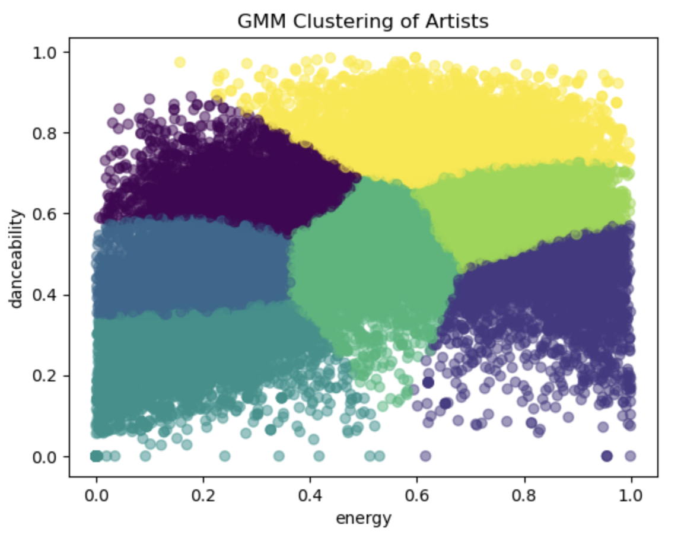
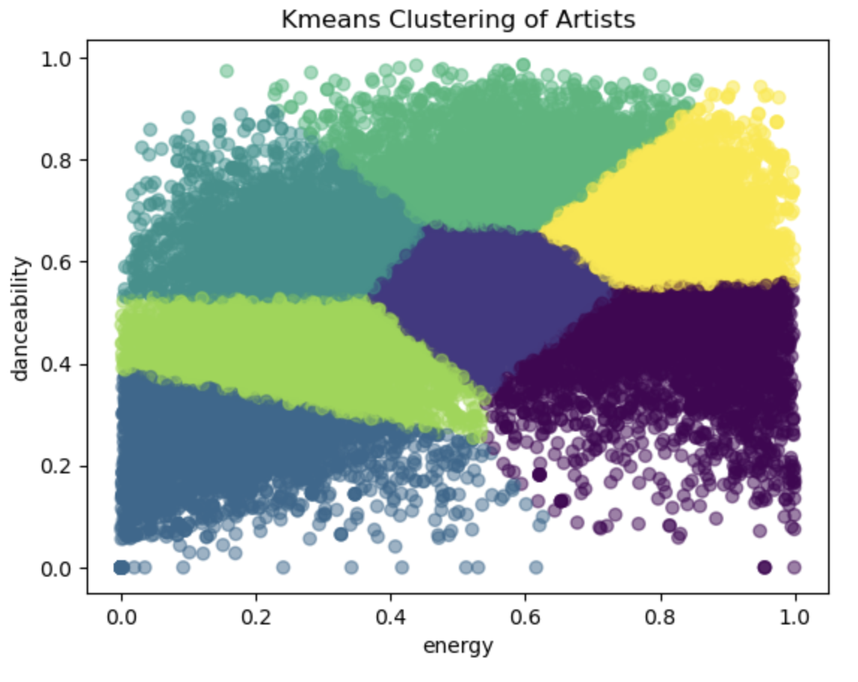
Visualizations
2 column clustering on Artists

Slide 7
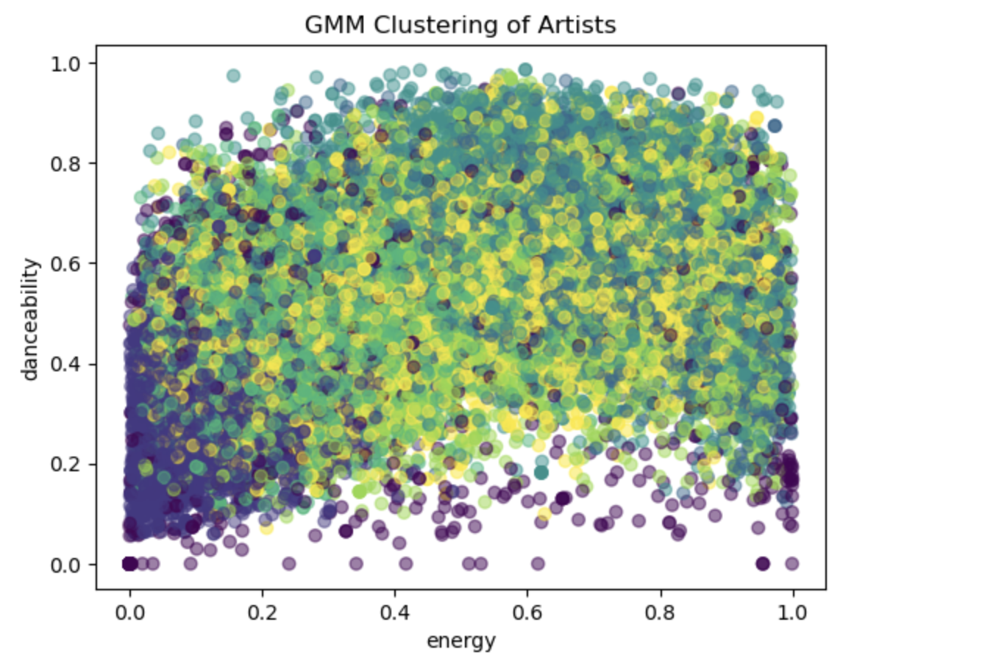
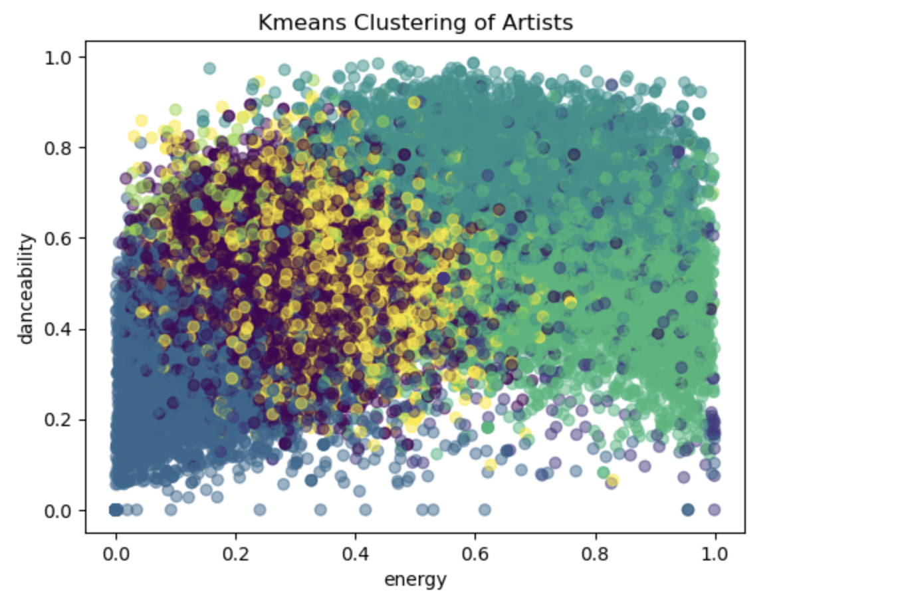
Visualizations
11 column clustering on Artists

Slide 8
Analysis
Increasing the number of columns can lead to stronger and more complex models
However, it can suffer from the curse of dimensionality and distorting the similarity and proximity of points
Decreasing the number of columns can simplify computations and enhance interpretability thus improving clustering quality
However, it can hurt clustering through information loss and lack of complexity
It is crucial that we work through each of the features and determine which predictors are most essential in the artist’s clustering outcome

Slide 9
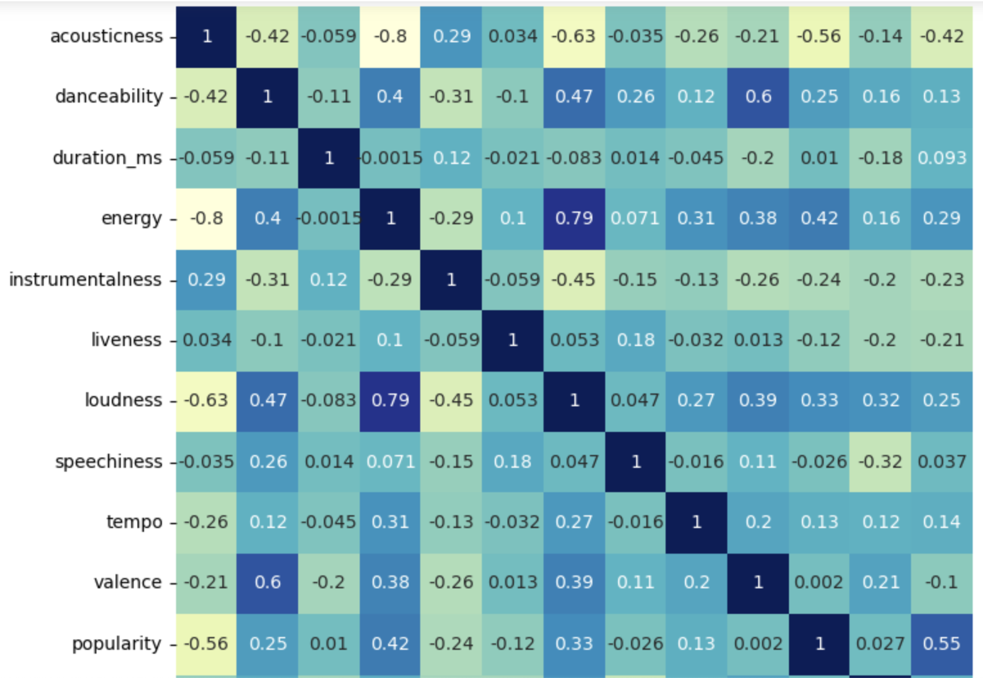
Correlation Heatmaps
Correlation by Artist

Slide 10
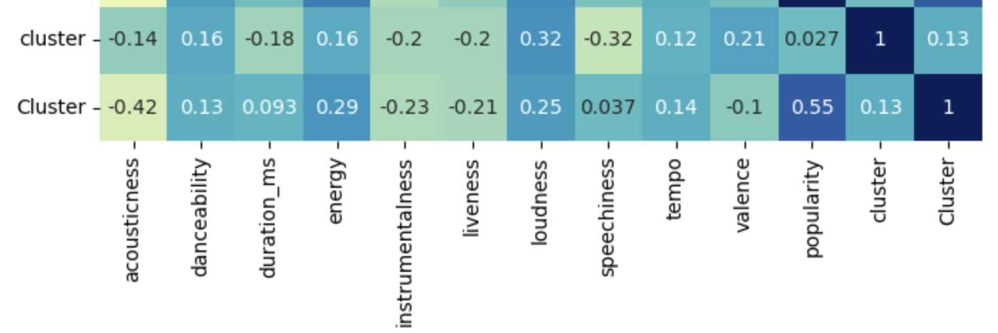
Correlation Heatmaps
Cluster by Artists
For GMM clustering by artists (top), danceablility, energy, loudness, tempo, valence and popularity are most highly correlated to which cluster the artist is in.
For K-Mean clustering, that remains constant while adding duration and speechiness and removing valence
Overall, loudness, energy, danceability, tempo, popularity all correlated together

Slide 11
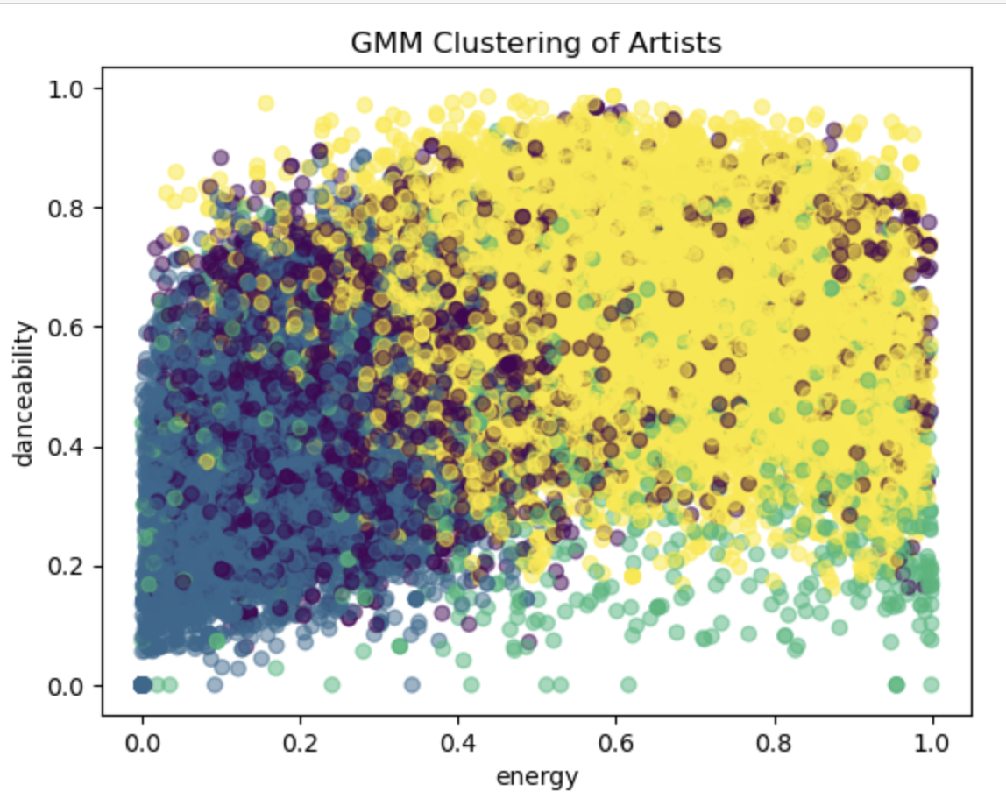
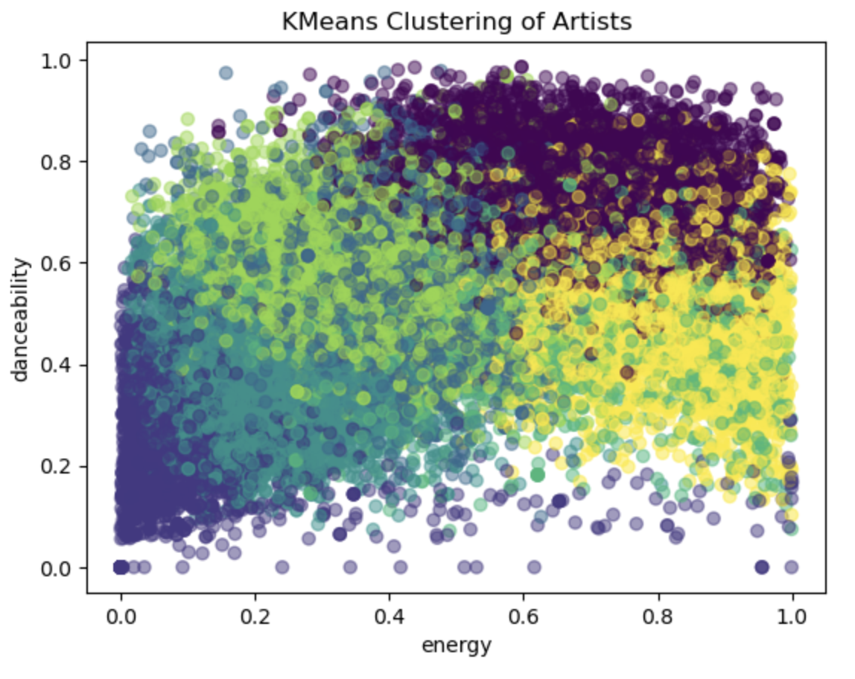
Final Clustering
5 Columns: loudness, energy, danceability, tempo, popularity

Slide 12
Conclusion
For the Spotify Data Set, using K-Means is the best method
Large Amount of Data
Even Distribution with thousands of data points between 0 and 1
Able to handle the complexity of the set while still maintaining computational efficiency

